Slide 1
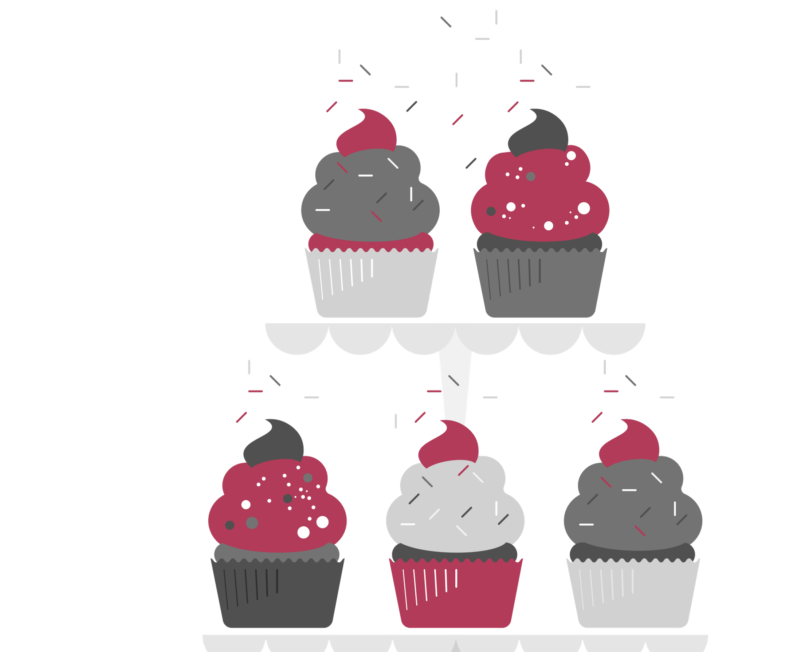
Sweet!! Or too sweet?
STAT 628 – M3 – Project
Niharika Chunduru
Siyan Wang
Yiyuan Li

Slide 2
The problem we wish to address
Santa Barbara, CA has a very interesting community of Bakery business owners
Since 2005, more than a third of the bakeries got shut down over the years
When we explored the data, we found some interesting findings that might have led to the closing of these businesses
We wish to provide a comparative analysis of the open and closed bakeries to advise any new owners on the factors affecting a business in the bread world

Slide 3
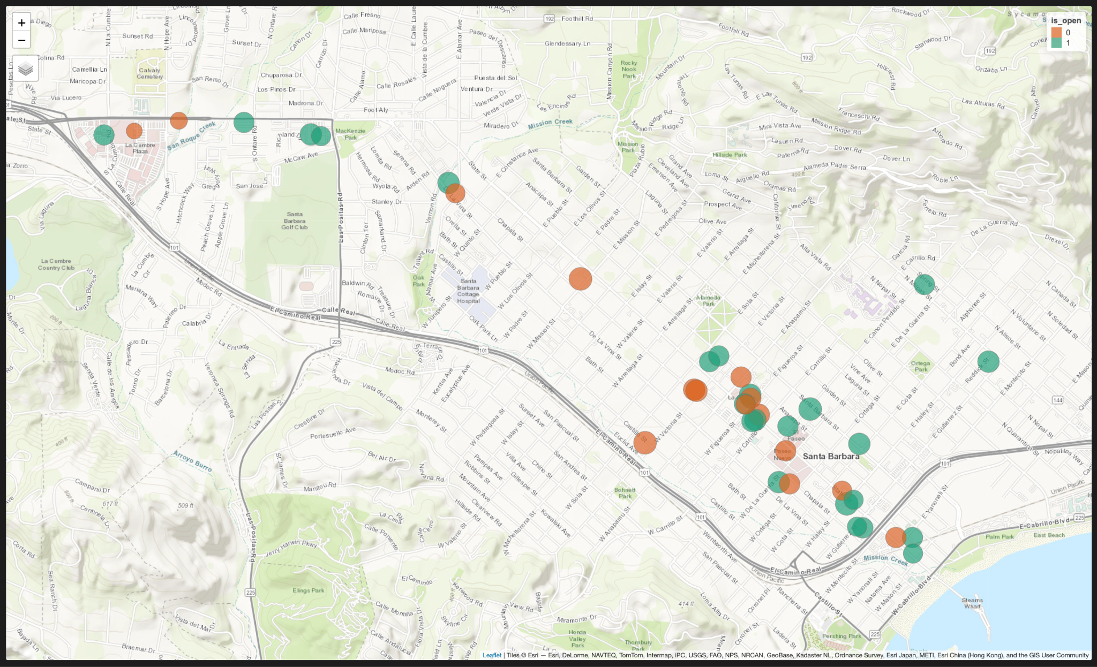
Notes:
This is a map-view of all the bakeries in Santa Barbara, CA.
For the sake of data credibility, the bakeries that have less than 50 reviews over the years have been eliminated
The open businesses have an average rating of 3.6 or higher.
Surprisingly, many of the closed bakeries have a rating of 3.5 or more. We wish to dig into the reviews dataset to analyze what might have led them to shut down
From the map, it is implicit that location might not be a cause of closure, given that there are open bakeries surrounding the ones that closed.
But that precisely, could also be the reason for closure. It could be possible that the businesses that closed were not able to keep up with the business model of the open ones.
So, we plan to highlight the factors differentiating both types of businesses (Using business attributes)

Slide 4
The problem we wish to address
Santa Barbara, CA has a very interesting community of Bakery business owners
Since 2005, more than a third of the bakeries got shut down over the years
When we explored the data, we found some interesting findings that might have led to the closing of these businesses
We wish to provide a comparative analysis of the open and closed bakeries to advise any new owners on the factors affecting a business in the bread world

Slide 5
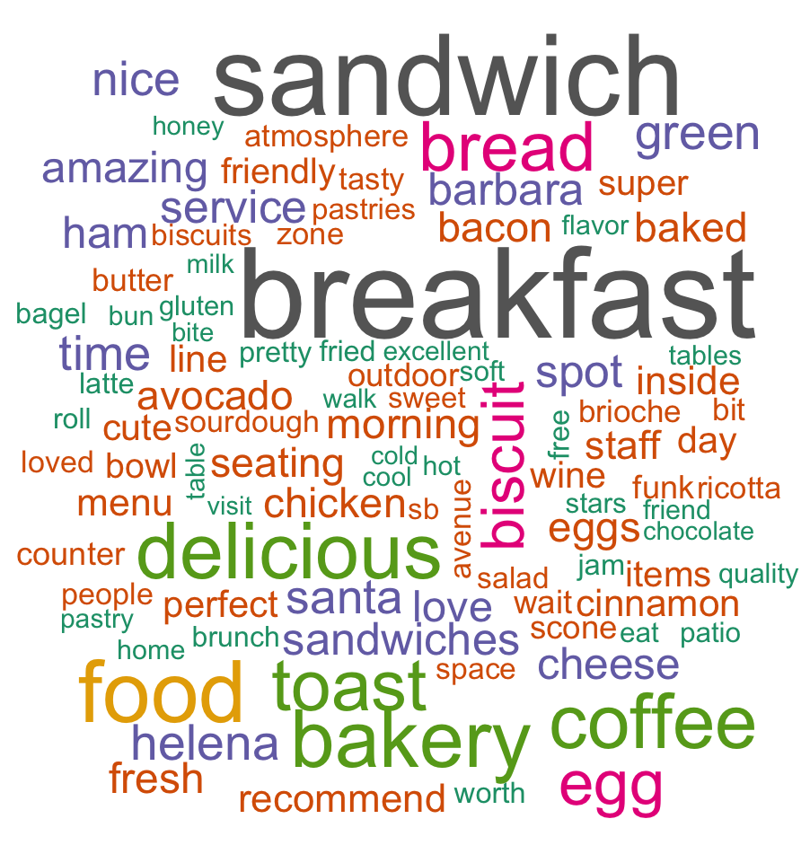

Review word analysis of an open bakery
 | Good Review (>3 stars) | Bad Review (<= 3 stars)
Review break-down | 319 | 82
Sentiment Ratio* | 4.19 | 1.02
* $\frac{Number of Positive words in review}{Number of Negative words in review}$

Slide 6
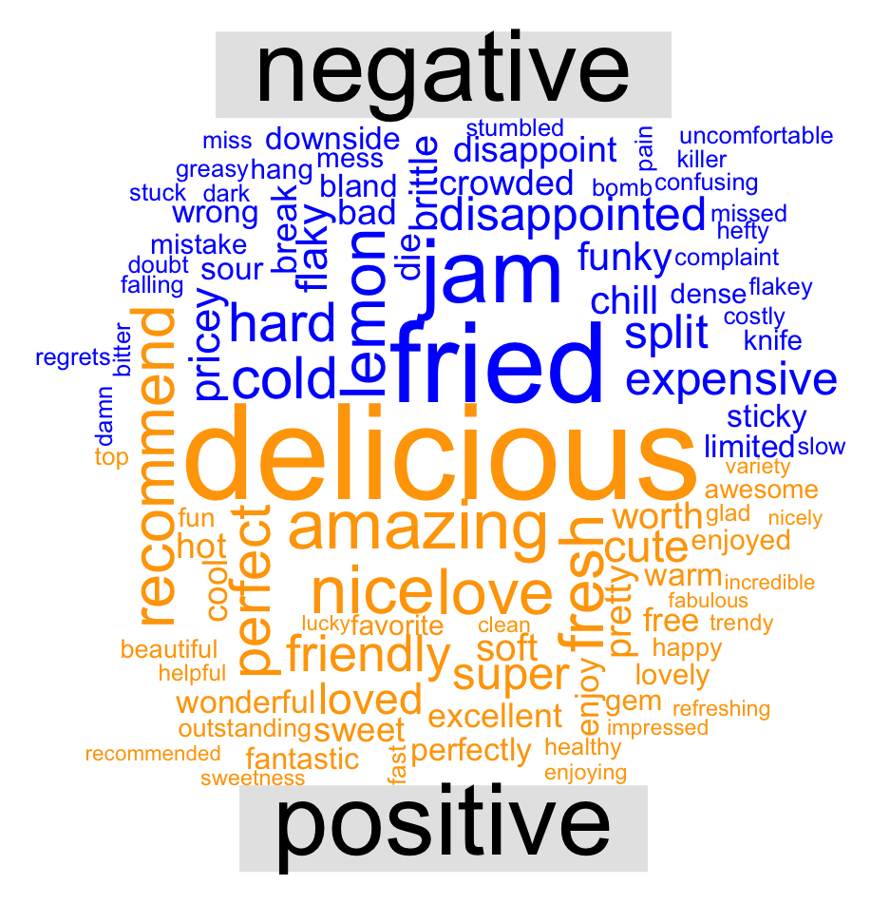
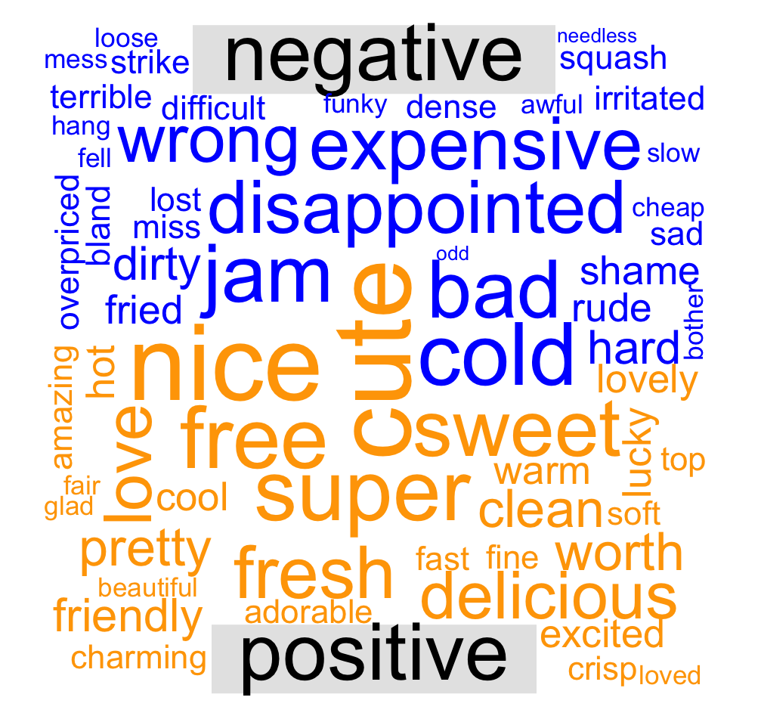
GOOD REVIEWS
BAD REVIEWS

Slide 7
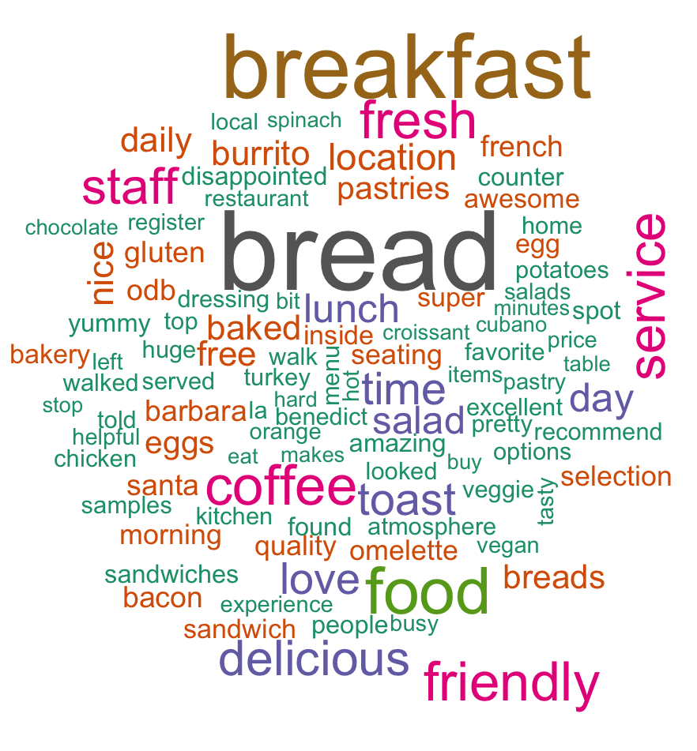
Review word analysis of a closed bakery
 | Good Review (>3 stars) | Bad Review (<= 3 stars)
Review break-down | 65 | 42
Sentiment Ratio* | 5.45 | 0.99
* $\frac{Number of Positive words in review}{Number of Negative words in review}$

Slide 8
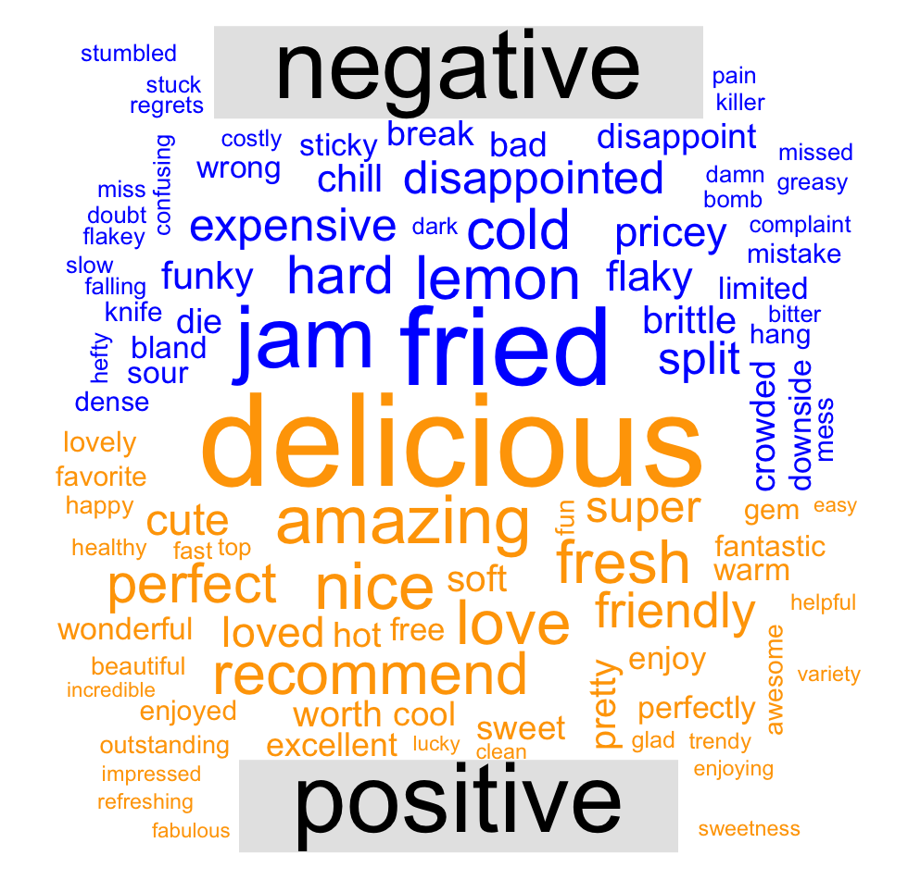
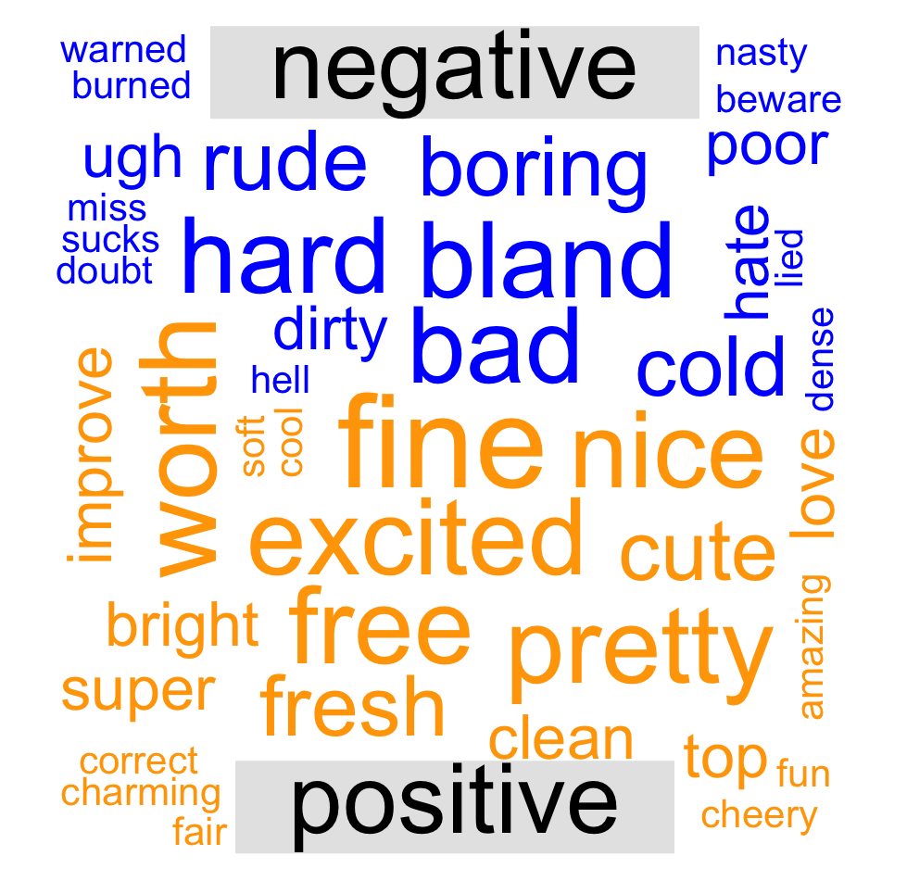
GOOD REVIEWS
BAD REVIEWS

Slide 9
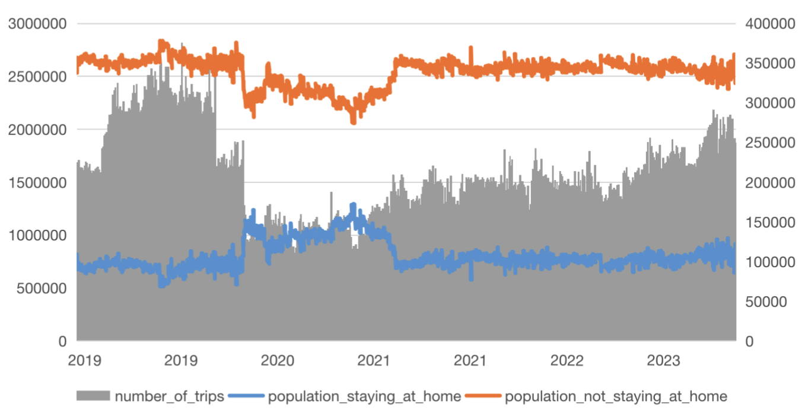
Population (not) staying at home
Number of Trips:
An obvious decline since 2020, and then rise gradually
Population staying or not at home:
A significant fluctuation during 2020, and then kept steady

Slide 10
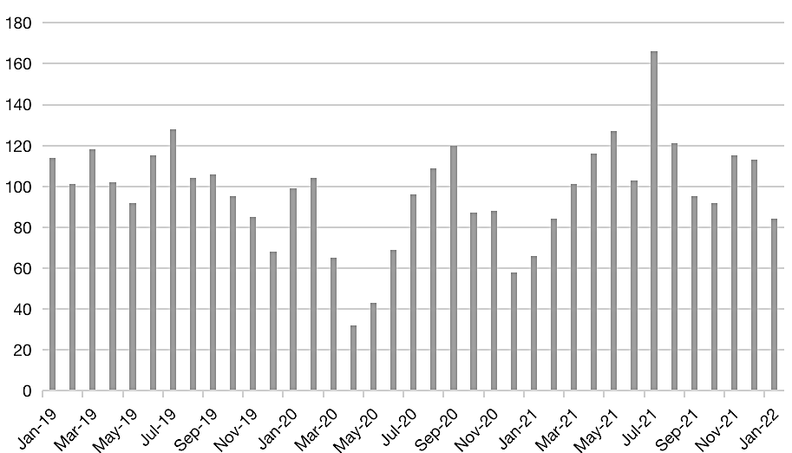
the number of bakery reviews in Santa Barbara
The total number of reviews in 2020 is less than those in 2019 and 2021, even though the drop is not as significant as the decline of the number of trips.
Pattern in other months:
Next step is to draw county trips chart by month to see if it’s related to the number of reviews.

